Slide 1

Sustainable growth from bioeconomy
The forest bioeconomy perspective
www.bioeconomy.fi

Slide 2
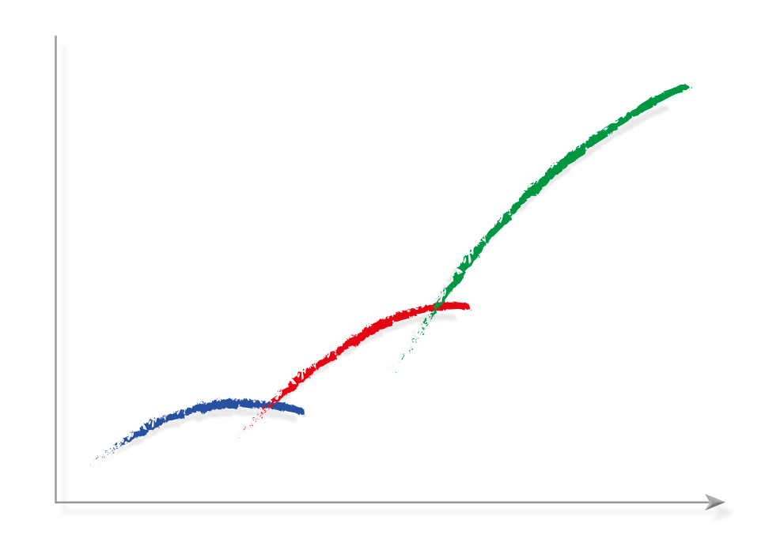
Bioeconomy: The next economic wave
GDP and
wellbeing
Fossil economy
Natural resource economy
1900
2014
2030
The next wave of economy is bioeconomy, which produces economic growth and wellbeing.
Finland is a bioeconomy superpower. We have plenty of natural resources, expertise and agility.
Notes:
Bioeconomy is the next wave of the global economy, producing growth and prosperity. According to estimates, Finland may nearly double the value of its bioeconomy.

Slide 3

Bioeconomy: Born from necessity
Due to population growth, by 2030 the world will need:
50 %
more food
45 %
more energy
30 %
more water
People are forced to find alternatives to non-renewable raw materials.
Climate change
Scarcity of non-renewable raw materials etc…
Notes:
By 2030, the world will need 50 percent more food, 45 percent more energy and 30 percent more water than now.

Slide 4



Bioeconomy is the solution
Bioeconomy:
decrease dependency on fossil raw materials
Aims:
Sustainably uses biological natural resources to produce goods, energy, food and services
prevent deprivation of ecosystems
promote economic development and create new jobs
Notes:
Bioeconomy is a branch of the economy using biological natural resources to produce products, energy, food and services. Clean, environment-saving technologies and efficient recycling are central to bioeconomy.

Slide 5
Bioeconomy’s significance in Finland
Turnover
€60bn
Share of employment
13%
Share of exports
26%
Finland seeks to increase its bioeconomy output to 100bn euros by 2025 and to create 100,000 new jobs in the process.
About half of Finland’s bioeconomy consists of forest bioeconomy.
Bioeconomy combines wood processing, chemistry, energy, construction, technology food and health.
Notes:
Finland is a global leader in bioeconomy – especially in forest-based solutions, bioenergy and solutions for wellbeing.
Finland is already offering the world sustainable bioeconomy know-how and products. We’ve developed expertise, technologies and smart solutions that aren’t found anywhere else. Besides timber products and paper, we use forest biomass in fibres, pharmaceuticals, chemicals, functional foods, plastic materials, cosmetics, intelligent packaging, biofuels and more.

Slide 6
Forest bioeconomy
Of our total land area, 80% is covered by forest, which is managed so that it produces significantly more wood than we currently use.
The forest-based industry is a Finnish pioneer in bioeconomy.
It utilizes renewable natural resources while incorporating economic, social and ecological sustainability in its activities.
The annual growth of Finnish forests
100 mill m³
Annual industrial use
55 mill m³
Notes:
Finland’s rise to become one of the world’s most prosperous countries is based on our ability to utilize renewable natural resources – our green gold. Forests and clean nature are – and have always been – the basis of our existence. Finland has top-notch expertise in sustainable forest bioeconomy. Some 80 per cent of our land area is covered with forest, which we manage so well that more timber grows every year than we utilise. We also use waste and side streams efficiently.

Slide 7

Teaming up to build a bioeconomic future
Cooperation and combination of technologies make Finland a true pioneer in bioeconomy.
Finland has strong expertise in forest, technology, construction, energy, chemistry as well as in food and health.
Together we have developed know-how, expertise, technologies and solutions that are not found anywhere else.
Notes:
Finland has strong know-how in technology, construction, energy, chemistry, food and health sciences. Innovation, cooperation and combined technologies in these fields make Finland a real pioneer in bioeconomy.

Slide 8
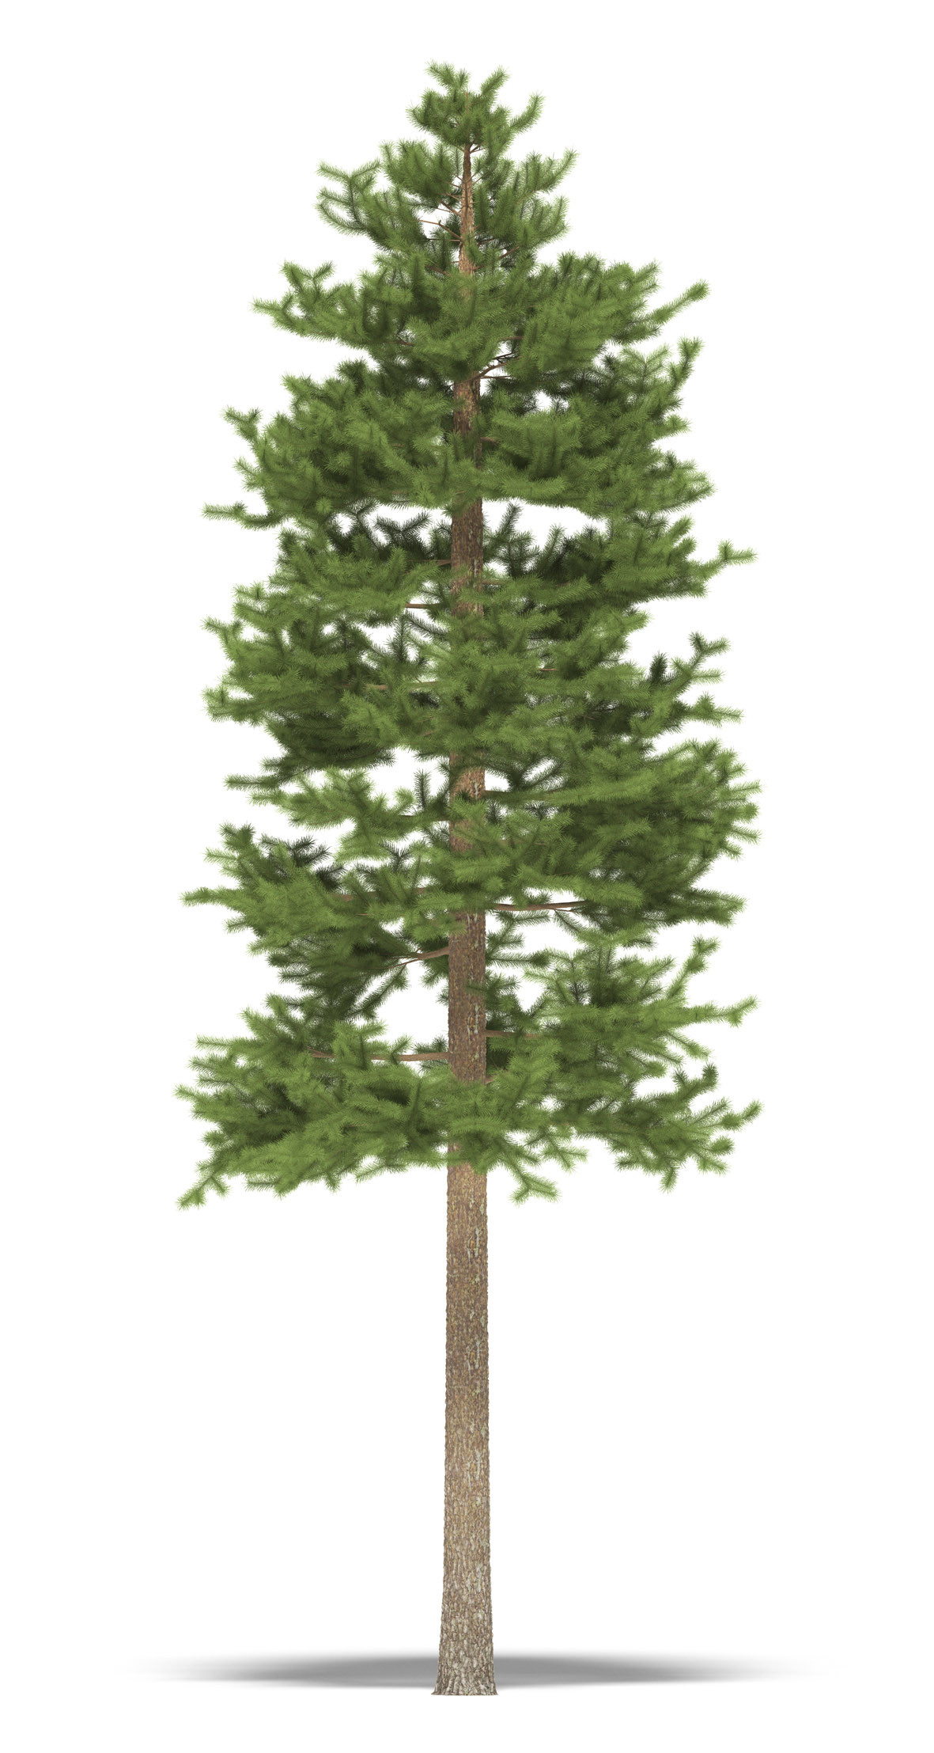
Wood will serve many functions in the future
Examples of products :
“Remote-controlled” paper price tags
Sound systems and car parts made of wood composite
Biodegradable packaging materials
Flexible screens made of nanocellulose
Intelligent packaging that monitors the intake of medicine or edibility of food products

Slide 9
Chemistry enables bioeconomy
Finland has plenty of expertise in chemistry, biochemistry and processes connected to handling biomasses.
About a third of chemical industry companies use bio-based raw materials. The use of these and biotechnology are on the increase.
Smart refinement and use of biomasses, recycling and water purification.

Slide 10
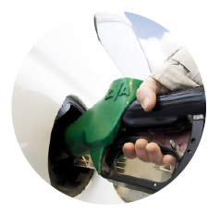

Biobased chemistry
Examples close to consumers:
Advanced biofuels
Cellulose gum as yoghurt thickening agent and tall oil products for glues
Car tyres containing natural rubber and oils
Cosmetic creams containing forest berry ingredients
Biobased materials for packaging and medicine
Paints containing binders based on vegetable oils

Slide 11
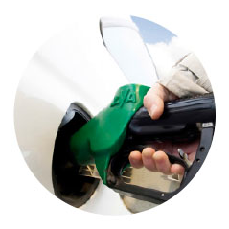
Energy from biomass
Renewable energy replaces fossil fuels and combats climate change.
Finland is a global pioneer in the co-production of electricity and heat. This makes it possible to use wood-based fuels extensively and energy-efficiently.
New technology to refine biomass into pyrolysis oil, bio-gas and bio-coal will significantly increase the options to utilize bio-energy.
Most of Finland’s renewable energy is forest based.

Slide 12
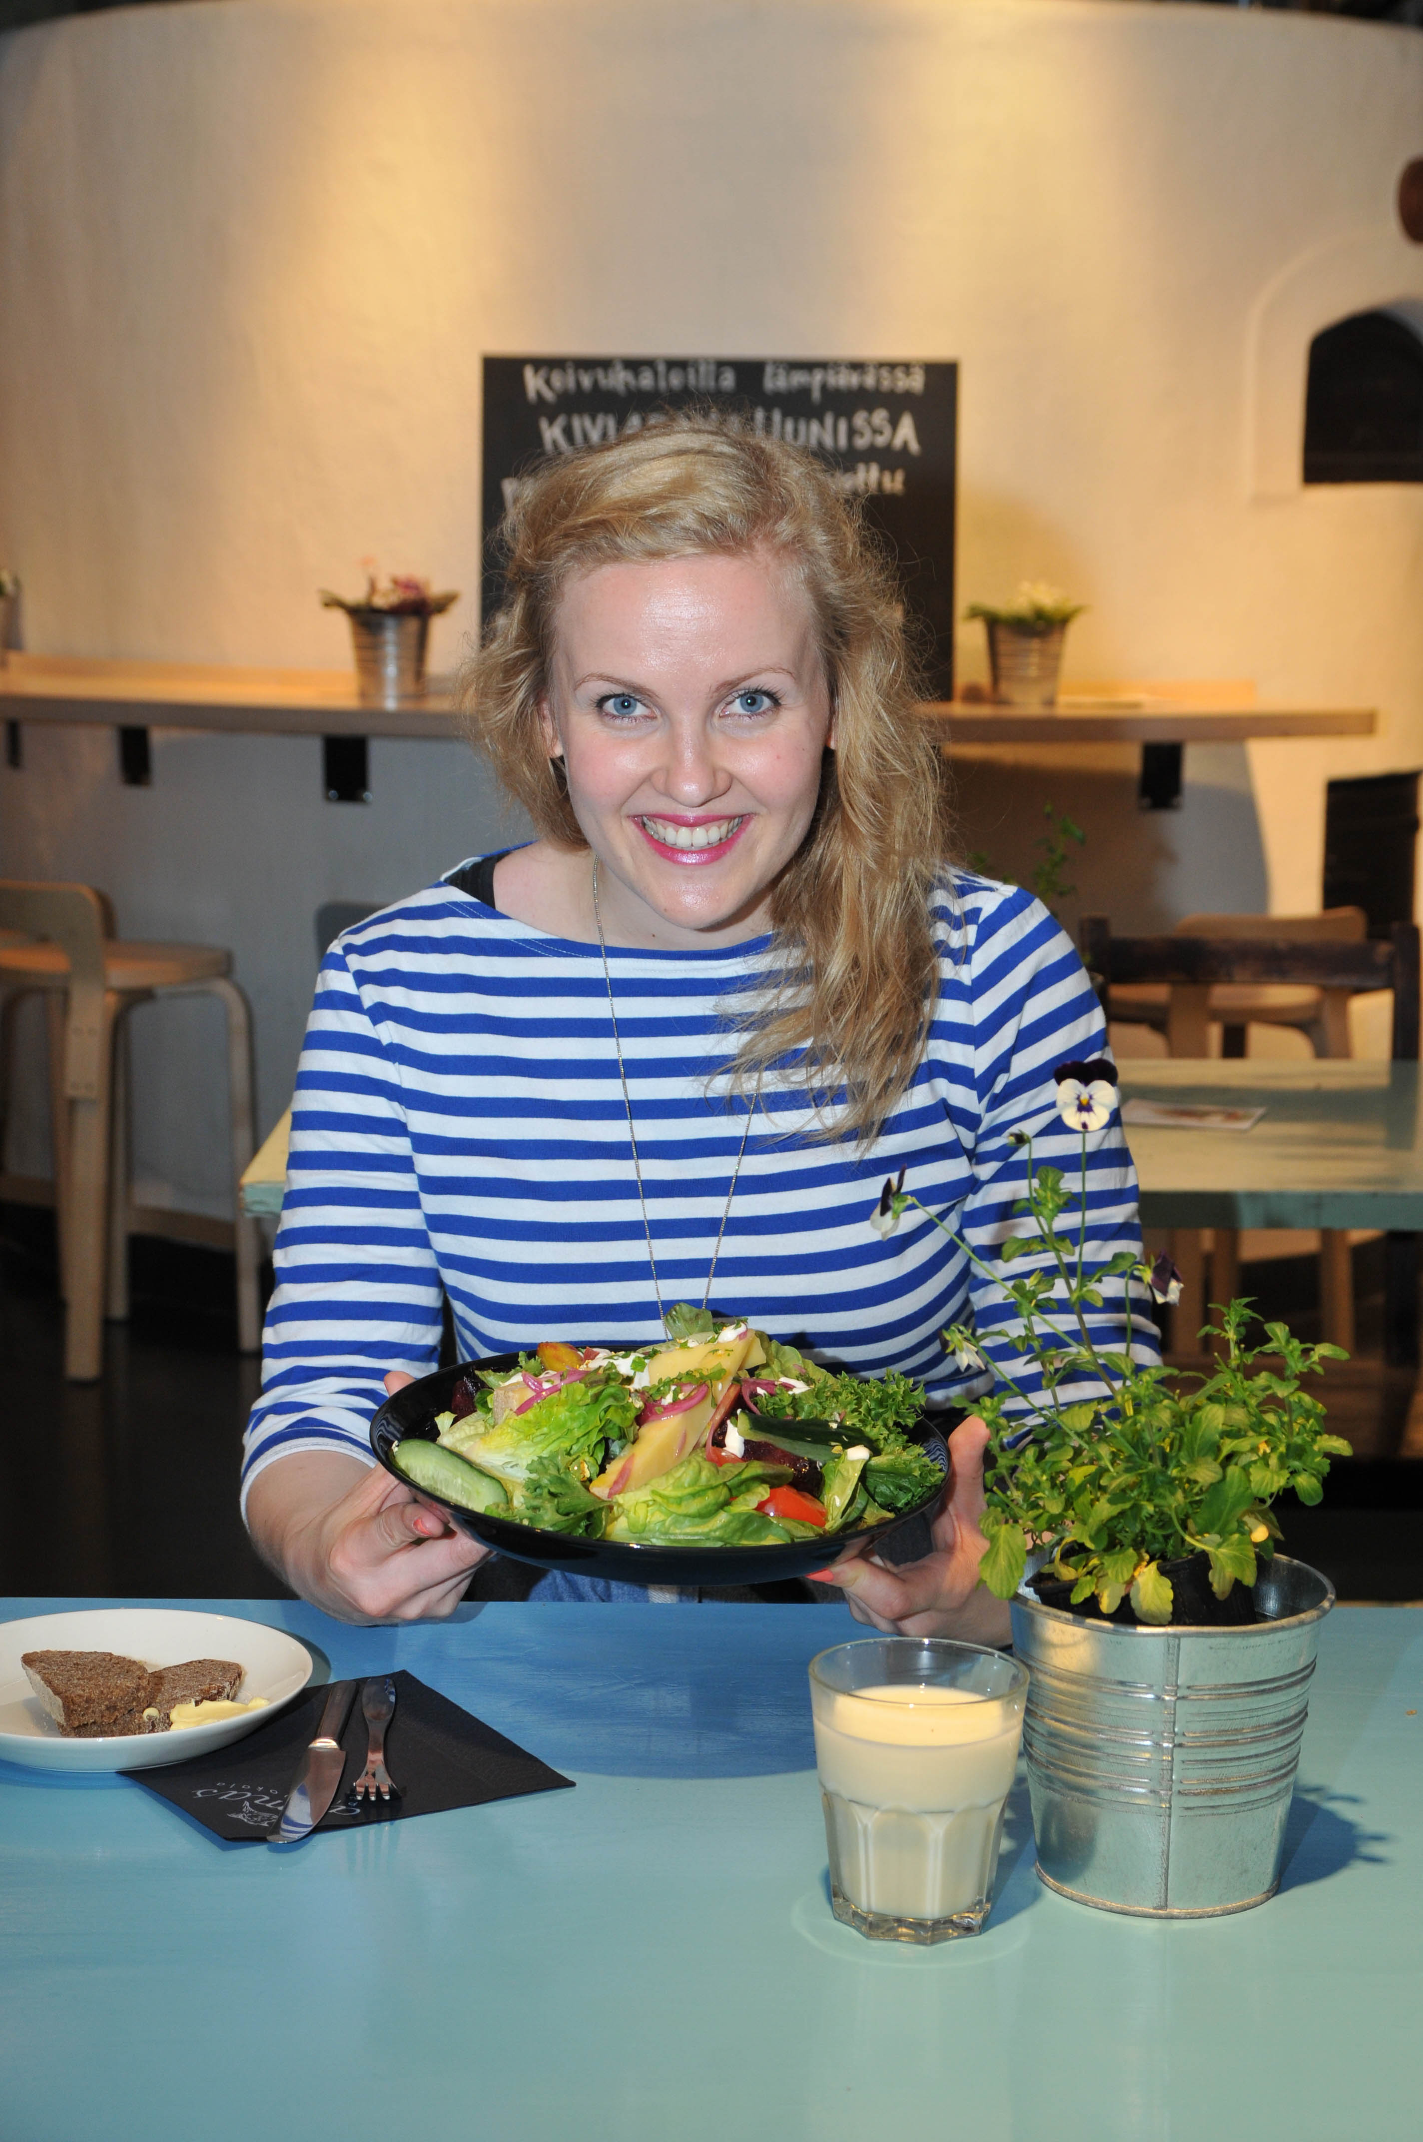
New food systems and decentralized solutions
New business operations are created in the chemical and energy industries by utilizing closed cycles in food systems, bio-processed products and livestock production sidestreams as well as field biomasses.
Decentralized and regional operational models are being supplemented with local food production, regional energy self-sufficiency and vitality.
Finland possesses high-standard expertise in the development of functional foods.
Natural products produced in accordance with new consumer trends offer the bio-economy new business opportunities.

Slide 13
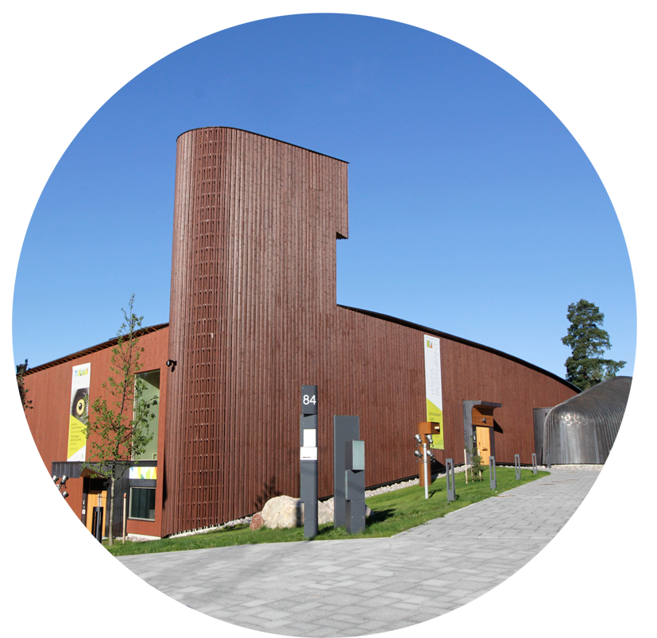
Wooden construction boosts wellbeing
A built environment containing wood has been shown to increase people’s wellbeing.
Wooden construction can cut a building’s carbon footprint by 15-30%.
Thanks to new innovations, wood offers more versatile solutions for building and interior design.

Slide 14
Health from the forest
Side streams of pulp production can be refined into:
Xylitol, a sweetener, which decreases the risk of dental cavities and children’s ear infections.
Pitch
Birch bark
is made into an ointment to treat skin cuts.
Research is being carried out on betulin from birch bark, which may lower the activity of HIV.
Plant sterol, which can lower cholesterol levels in blood.
Natural health promoting food ingredients, e.g. berries
Berries and mushroom

Slide 15
Solution-driven experts
Through cooperation and combining technologies, we can achieve wellness-promoting and sustainable products and services.
Technologies, procedures and expertise developed in Finland can be transferred and applied globally.
Bioeconomy solutions produced in Finland can advance sustainable global welfare.

Slide 16
Finland’s bioeconomy strategy
Strategic goals
1. COMPETITIVE ENVIRONMENT FOR BIOECONOMY
2. NEW BUSINESS FROM BIOECONOMY
3. STRONG KNOW-HOW BASE FOR BIOECONOMY
4. USABILITY AND SUSTAINABILITY OF BIOMASS
Implementation and monitoring
Sustainable bioeconomy solutions are the basis of Finland’s welfare and competitiveness.
Notes:
The Finnish government has adopted a national bioeconomy strategy, which was published in May 2014. The government has specified bioeconomy as one of the three key areas of Finland’s economic growth.

Slide 17
Bioeconomy value chains
Wood processing
Chemistry
Energy
Construction
Ecosystem services
Food
Biomass
Products
Expertise
Bioeconomy value chains produce goods, services and solutions sustainably
and through clean technologies e.g. cleantech
Notes:
“In bioeconomy, the focus is on a holistic approach across value chains from raw materials to consumer products and services and ensuring that value chains operate in accordance with the principles of sustainability.”

Slide 18
Ask a Finn!
www.bioeconomy.fi
Source of information: TEM
Ministry of Employment and the Economy, Finland
Notes:
Have a question you want to solve sustainably through bioeconomy? Ask a Finn for advice.

